Slide 1
Credit Risk Prediction using ML
Presented by: Neethu Manikantan

Slide 2
Project Overview
Problem: Banks and lenders face financial losses when customers don't repay loans. Identifying risky borrowers is crucial.
Solution: This project builds a smart system to predict how likely someone is to default on a loan.
Goal: Help lenders make better, faster decisions by providing a clear credit score and risk rating for each applicant.

Slide 3
Business Requirements
Recall on default class > 90%
Precision > 50% for default class
Model should have high AI explainablilty

Slide 4
Data Collection

Slide 5
Loans Table
loan_id
cust_id
loan_purpose
loan_type
sanction_amount
loan_amount
processing_fee
gst
net_disbursement
loan_tenure_months
principal_outstanding
bank_balance_at_application
disbursal_date
installment_start_dt
default
Customers Table
cust_id
age
gender
marital_status
employment_status
income
number_of_dependants
residence_type
years_at_current_address
city
state
zipcode
Bureau table
cust_id
number_of_open_accounts
number_of_closed_accounts
total_loan_months
delinquent_months
total_dpd
enquiry_count
credit_utilization_ratio

Slide 6
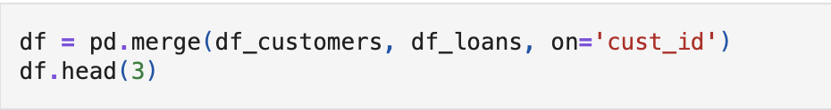
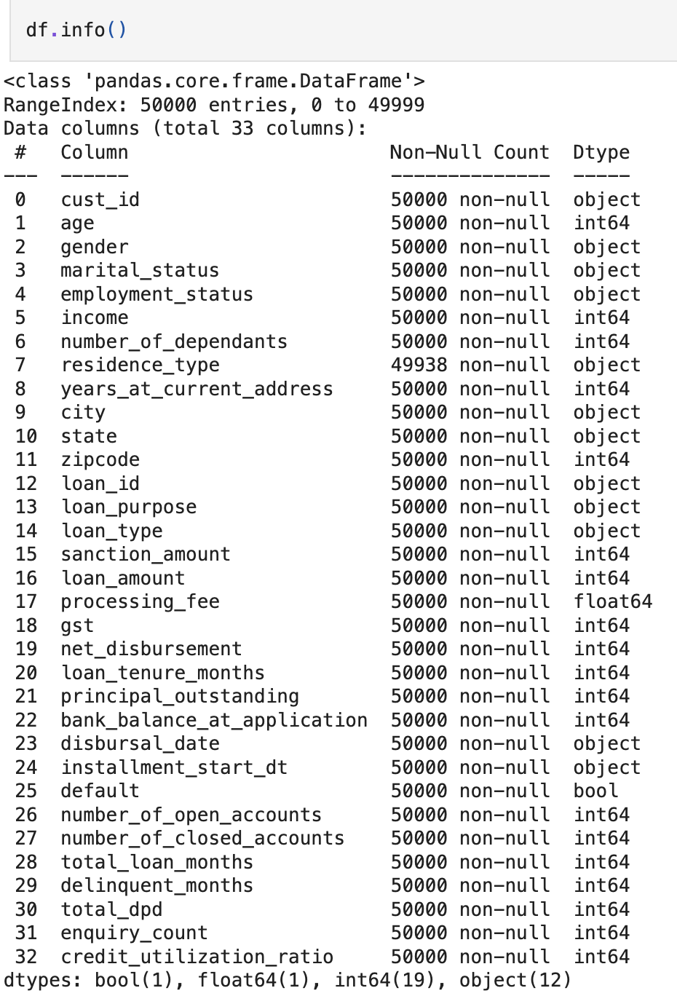
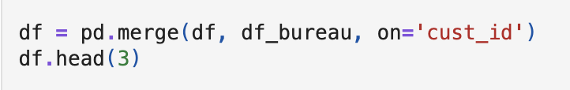
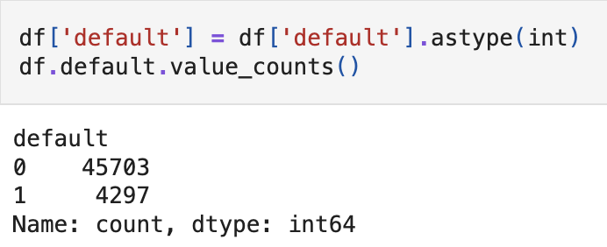
Class Imbalance
So use stratify to maintain class division in train and test

Slide 7
Data Cleaning

Slide 8
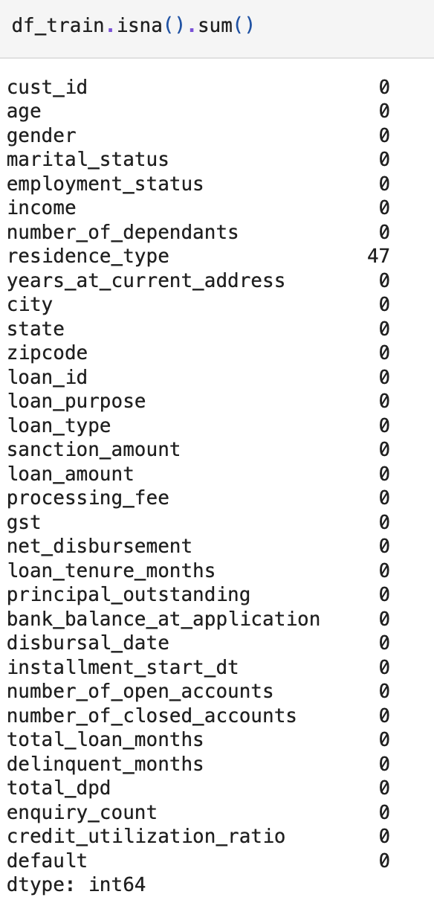
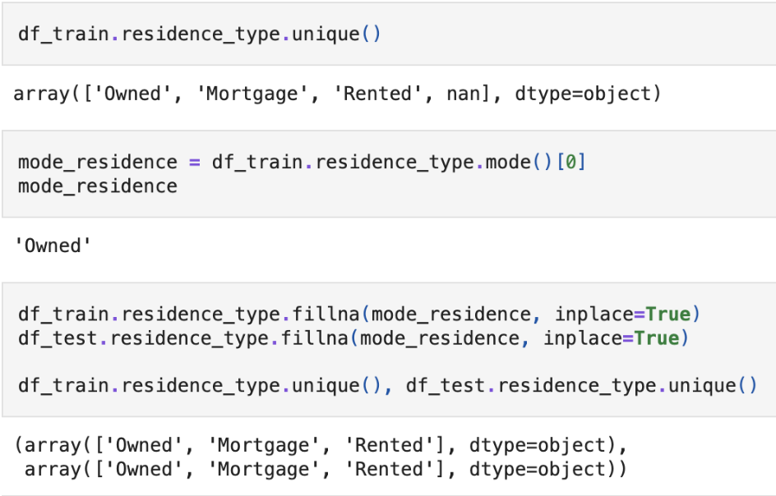

Slide 9
Exploratory Data Analysis

Slide 10
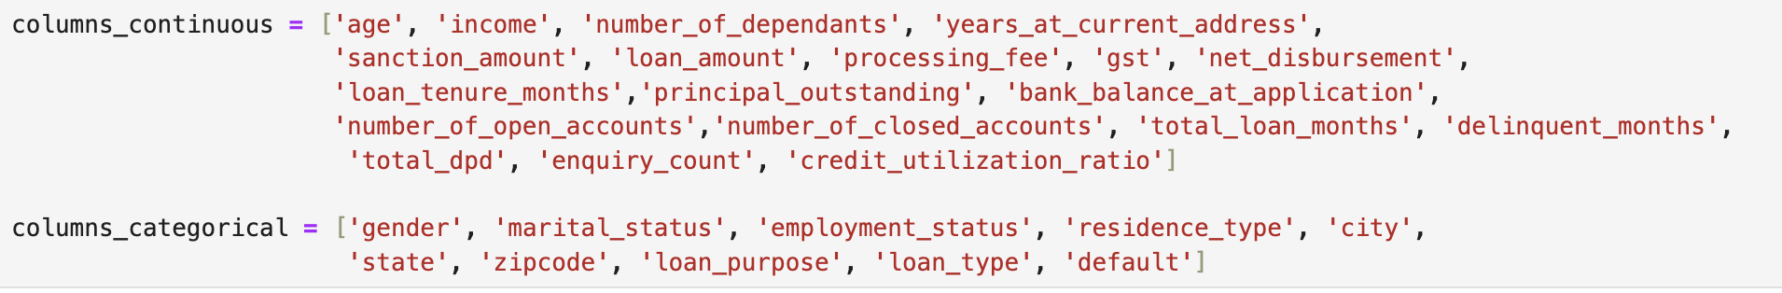

Slide 11
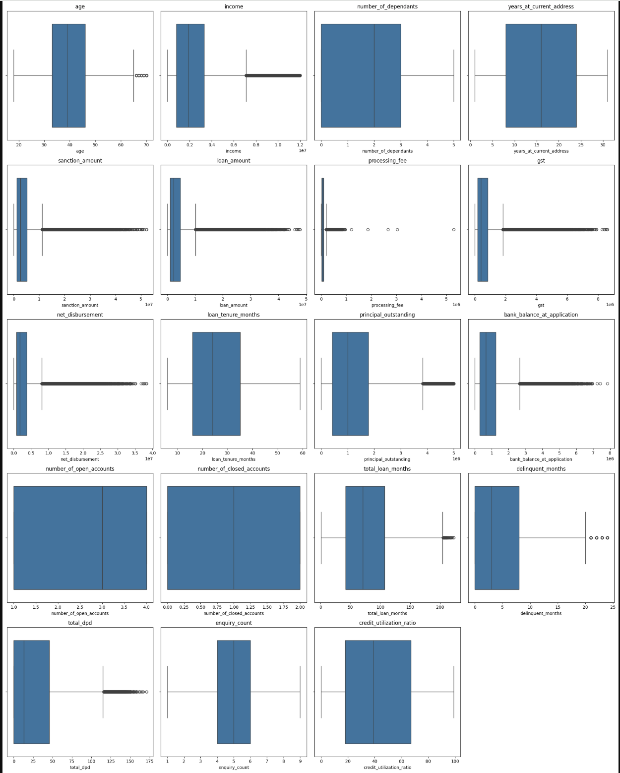
Numerical Columns analysis
Processing fee must be less than 30% of loan amount

Slide 12
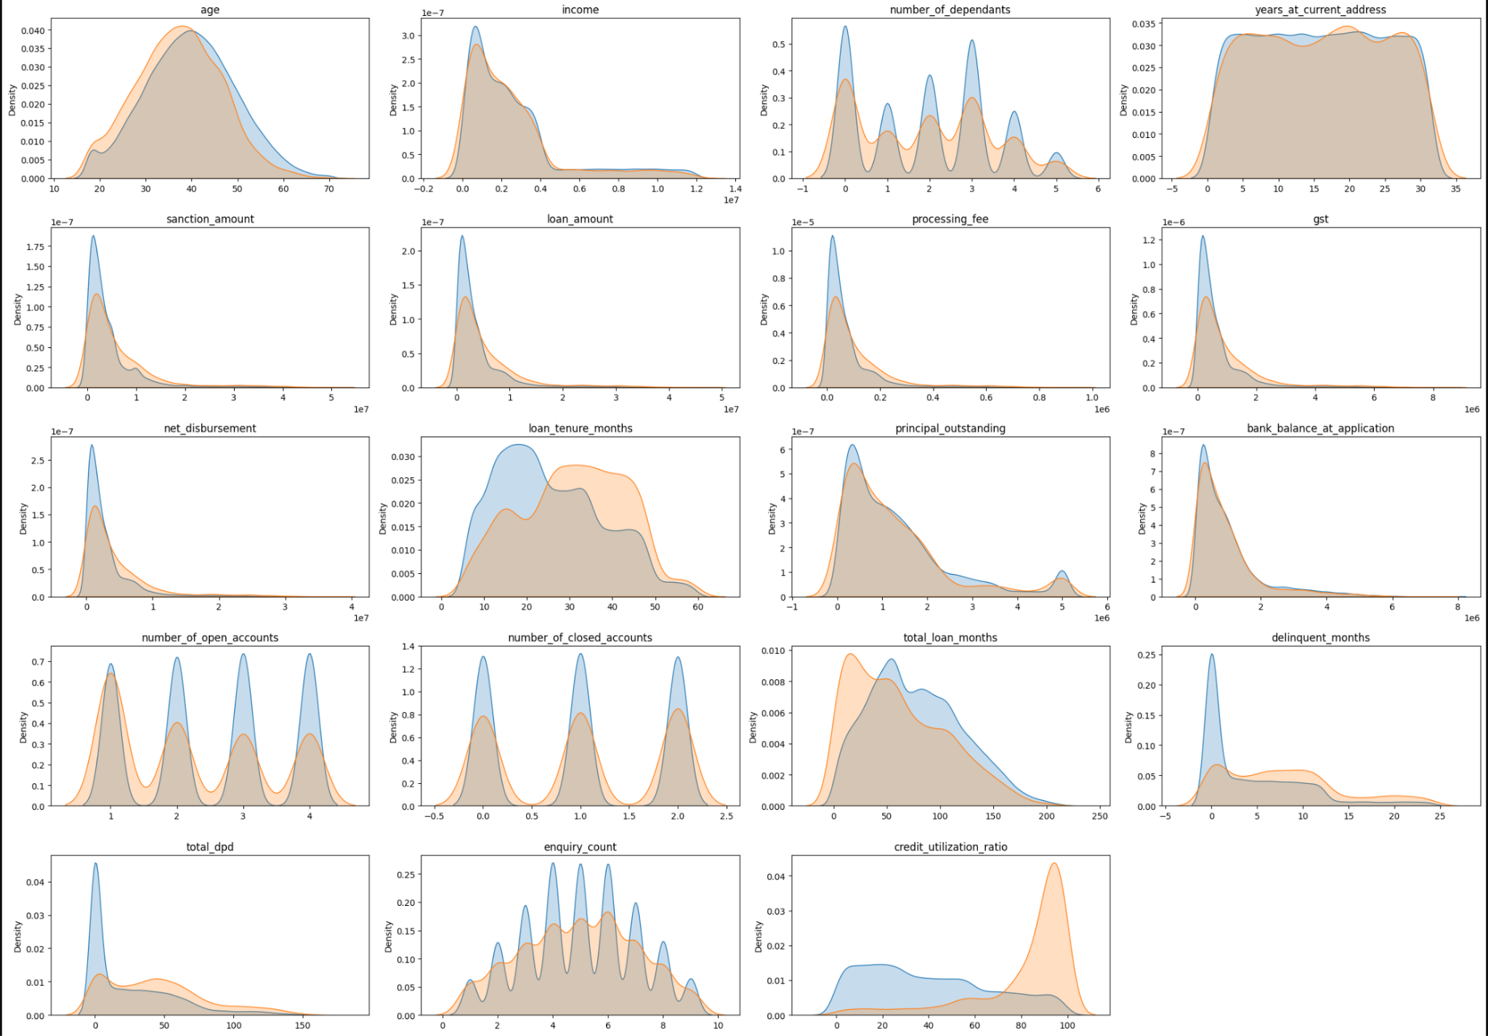
KDE for all the Numerical Columns
loan_tenure_months, delinquent_months, total_dpd, credit_utilization, higher values indicate high likelyhood of becoming a default. Hence these 4 looks like strong predictors

Slide 13
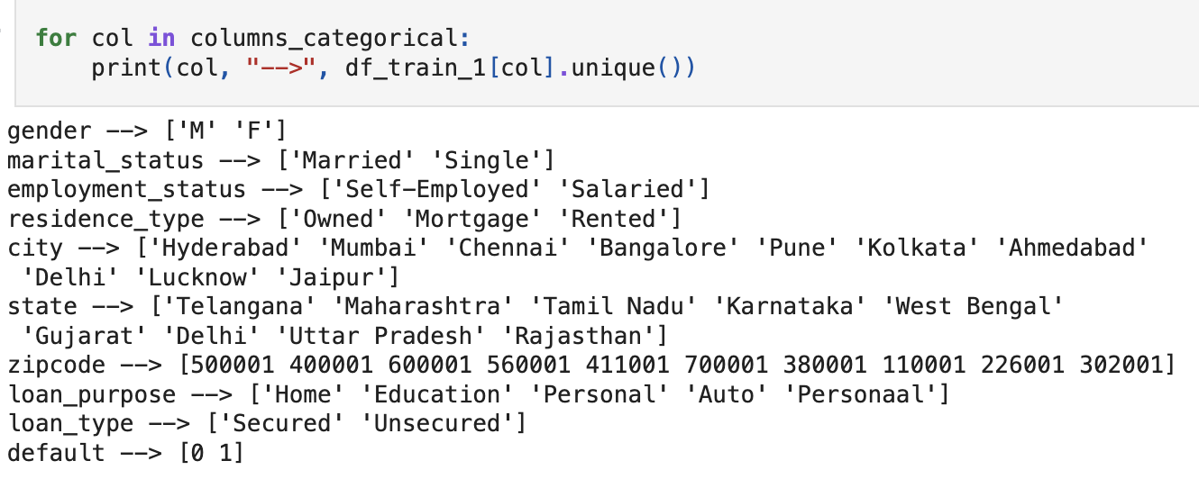
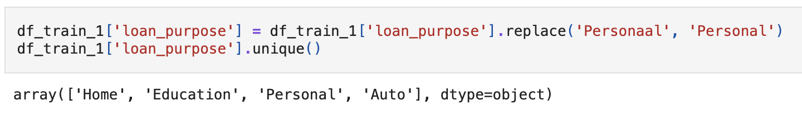
Categorical Columns analysis

Slide 14
Feature Engineering

Slide 15
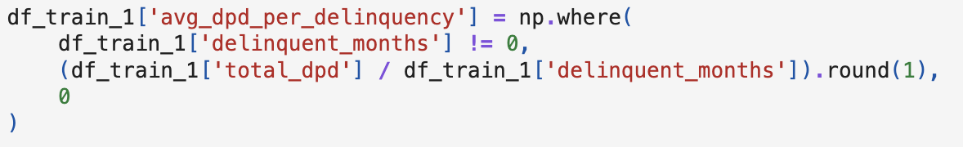
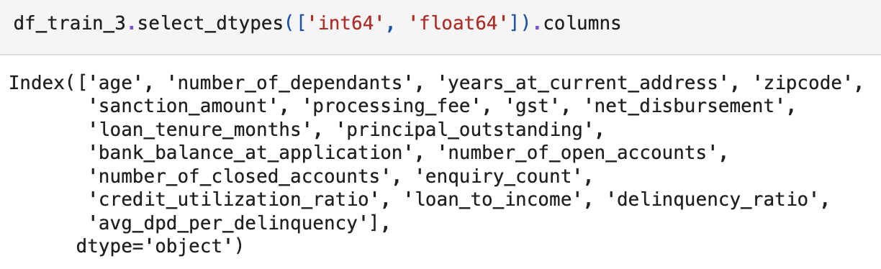
Derive new features - loan-to-income ratio, delinquency ratio, average days past due per deliquency
Drop unnecessary columns like ids and those as per business requirements

Slide 16
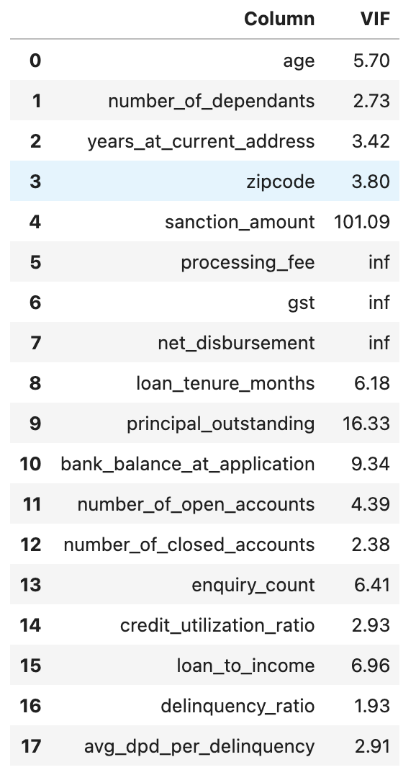
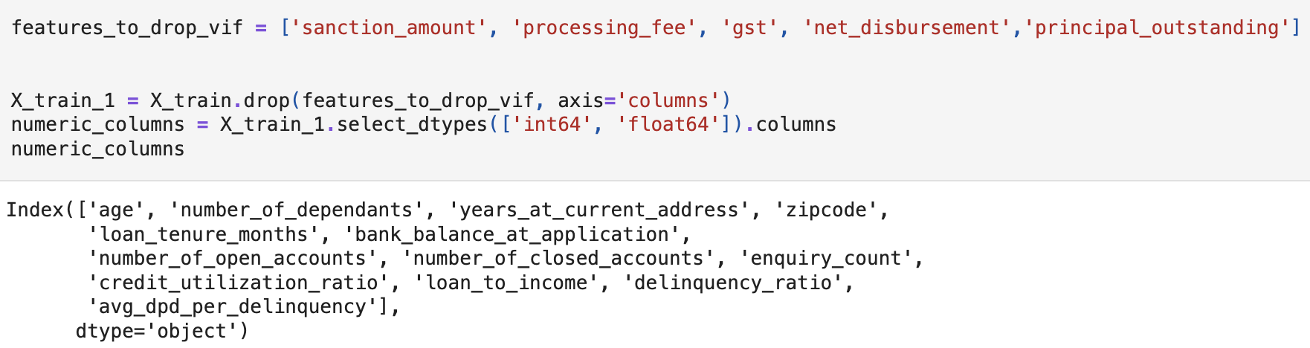
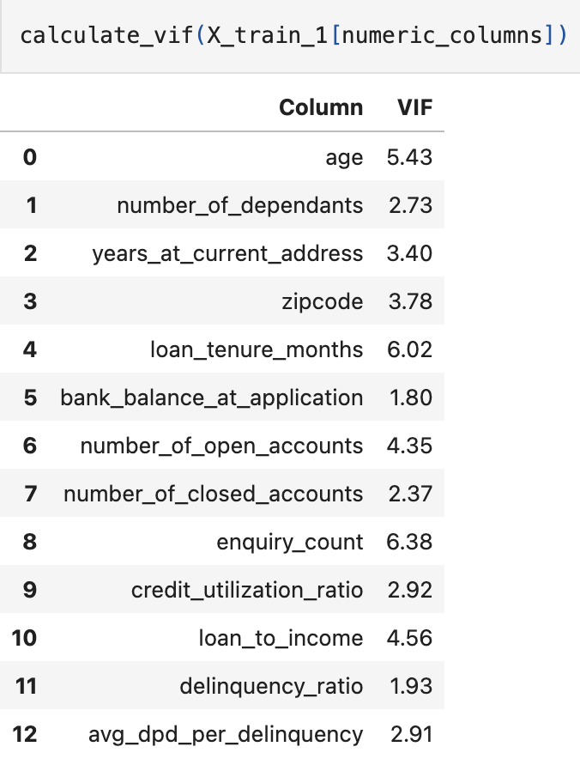
Calculate VIF to detect multicollinearity
Drop columns with vif > 10

Slide 17
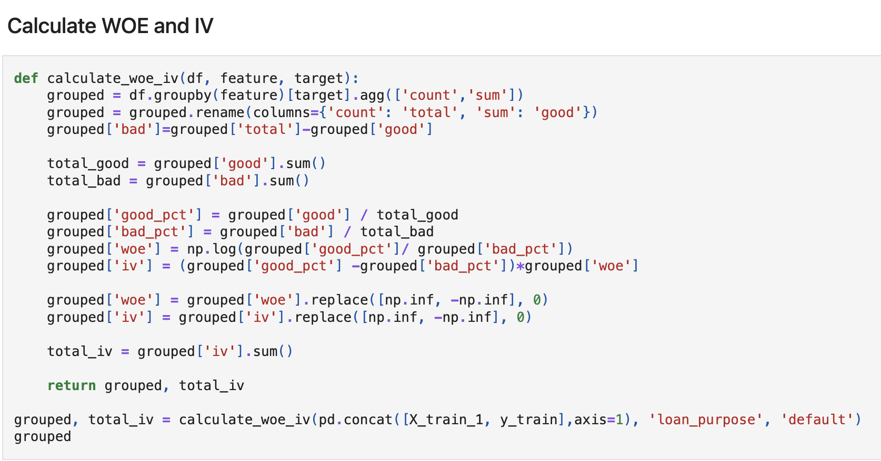
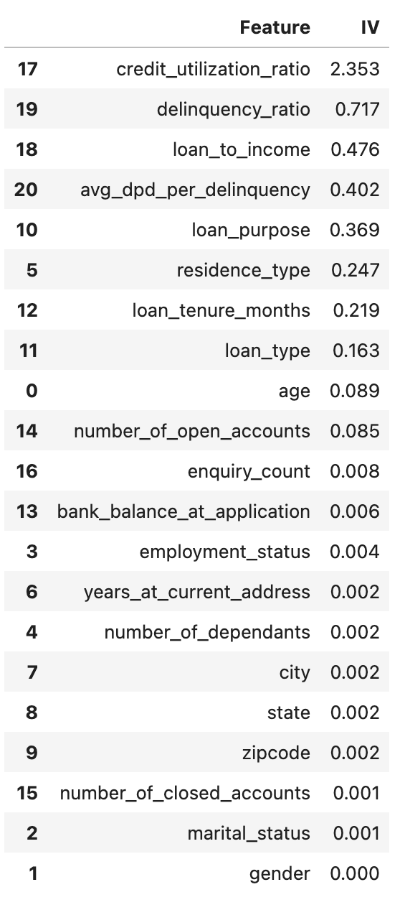
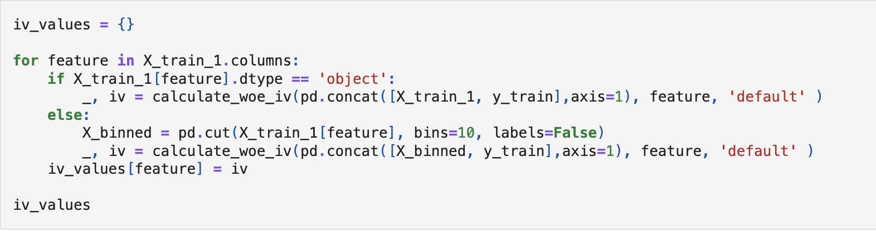
Select features with IV > 0.02

Slide 18
Model Training And Evaluation

Slide 19
Model | Precision | Recall
Logistic Regression | 0.84 | 0.72
Random Forest Classifier | 0.85 | 0.71
XGBoost Classifier | 0.82 | 0.76
RandomizedSearchCV + Logistic Regression | 0.83 | 0.74
RandomizedSearchCV + XGBoost | 0.78 | 0.82
Under Sampling + Logistic Regression | 0.51 | 0.96
Under Sampling + XGBoost Classifier | 0.52 | 0.99
SMOTE Tomek + Logistic Regression | 0.55 | 0.94
SMOTE Tomek + XGBoost | 0.72 | 0.86

Slide 20
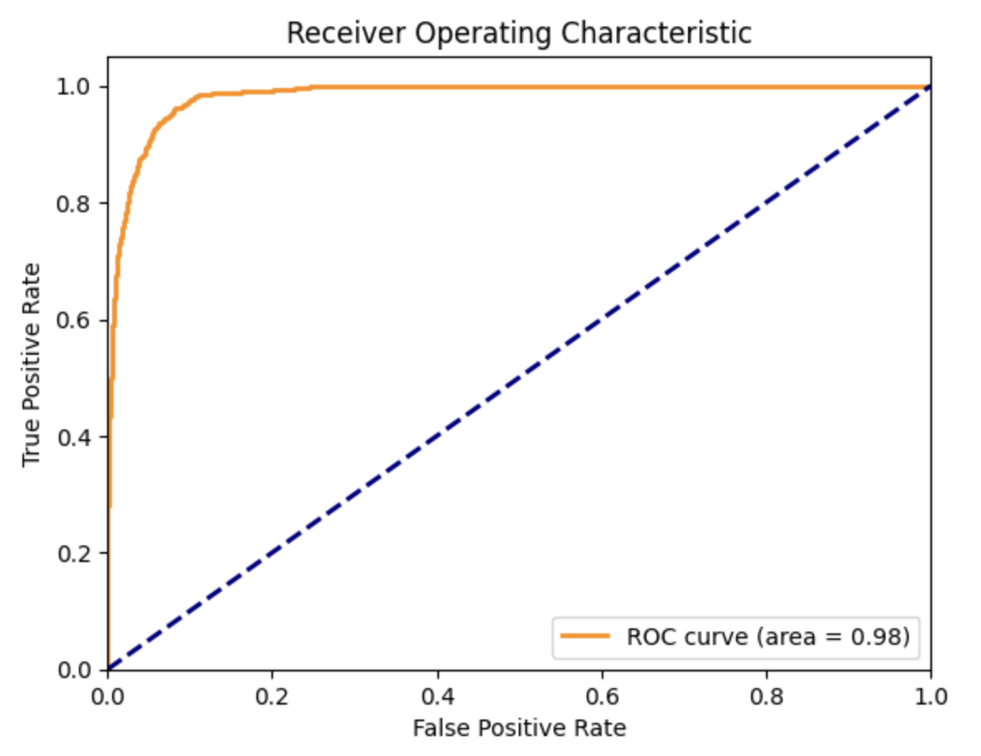
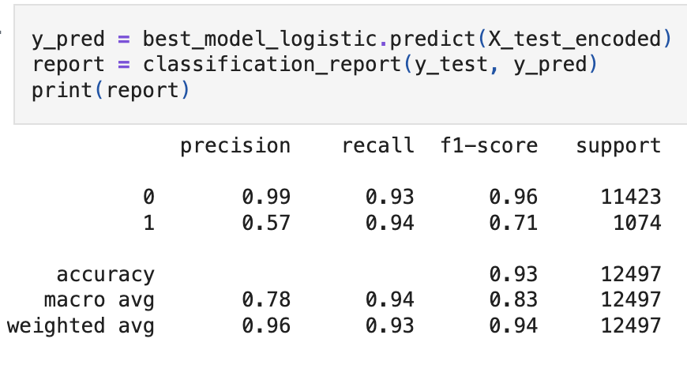
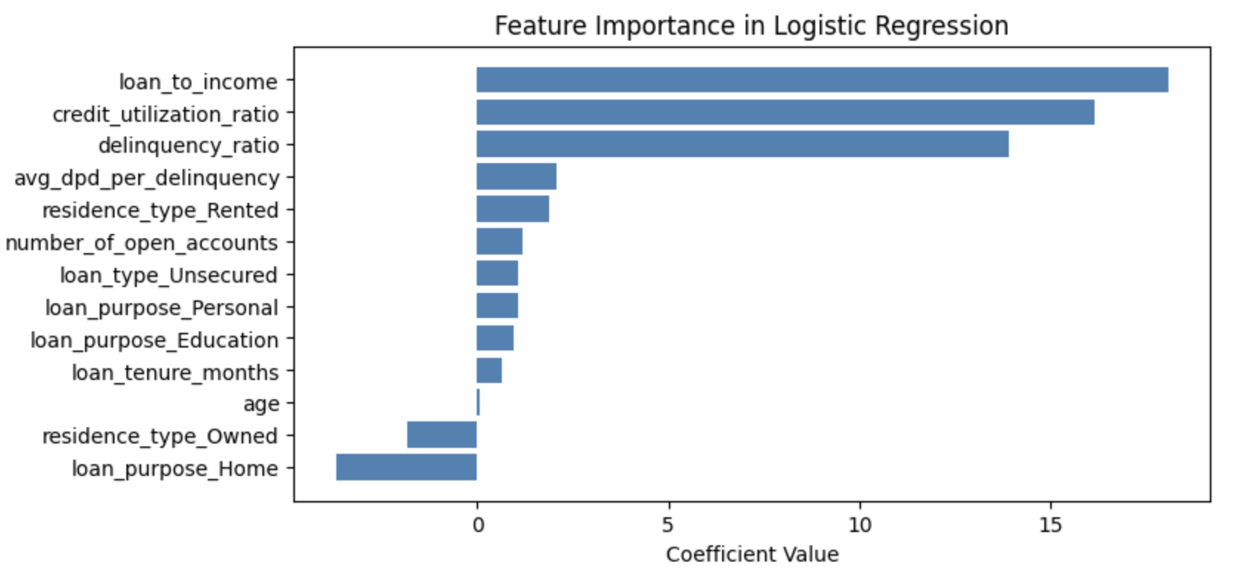
Final Model - Logistic Regression
To meet the business requirements of high AI explainablilty
AUC of 0.98: The model is very good at distinguishing between events and non-events.
UC - 0.98

Slide 21
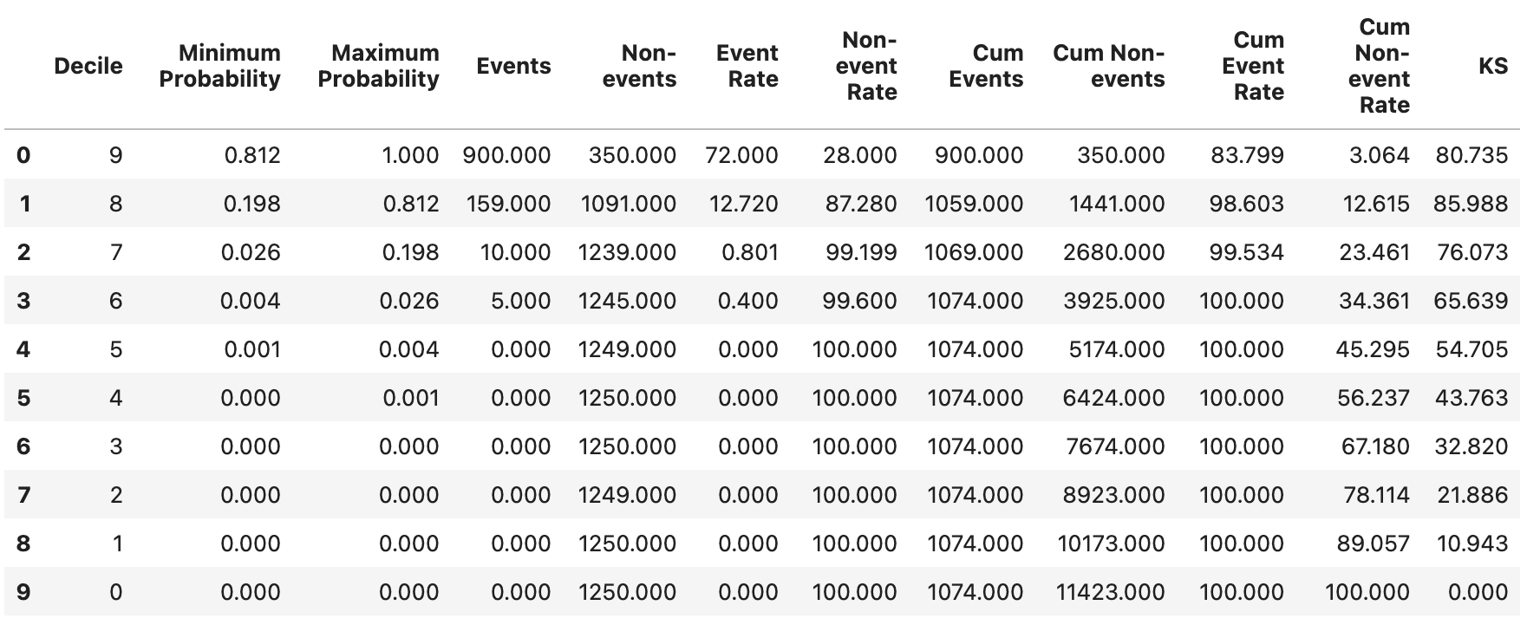
Model Evaluation using KS statistic:
The highest KS value is 85.98%, found at Decile 8.
This indicates that the model's performance in distinguishing between events and non-events is most significant at this decile.
If KS is in top 3 decile and score above 40, it is considered a good predictive model.

Slide 22
Front End
User-Friendly Interface: Built with Streamlit, making it easy to create input fields for customer details like age, income, and loan amount.
Data Input: Users enter relevant information about the loan applicant.
Displays Results Clearly: Once a prediction is made, it shows the default probability, credit score, and rating in an easy-to-understand format.

Slide 23
Backend
Loads the Trained Model: It loads the pre-built machine learning model and necessary tools (like the data scaler) from a saved file.
Prepares Input Data: Takes raw customer information and transforms it into the specific format the model understands. This includes calculating new features and correctly formatting existing ones.
Calculates Credit Score: Uses the loaded model to predict the probability of loan default and then converts this into a standard credit score (e.g., 300-900) and a simple rating (e.g., Good, Poor).

Slide 24
Workflow
User Input: A user enters applicant details into the main.py (frontend) application.
Request to Backend: When the "Calculate risk" button is clicked, the main.py application sends this data to the prediction_helper.py (backend).
Prediction by Backend: The prediction_helper.py processes the data, uses the loaded model to make a prediction, and calculates the credit score and rating.
Results to Frontend: The backend sends these results back to the main.py application.
Display to User: The main.py application then displays the final credit assessment summary to the user.

Slide 25
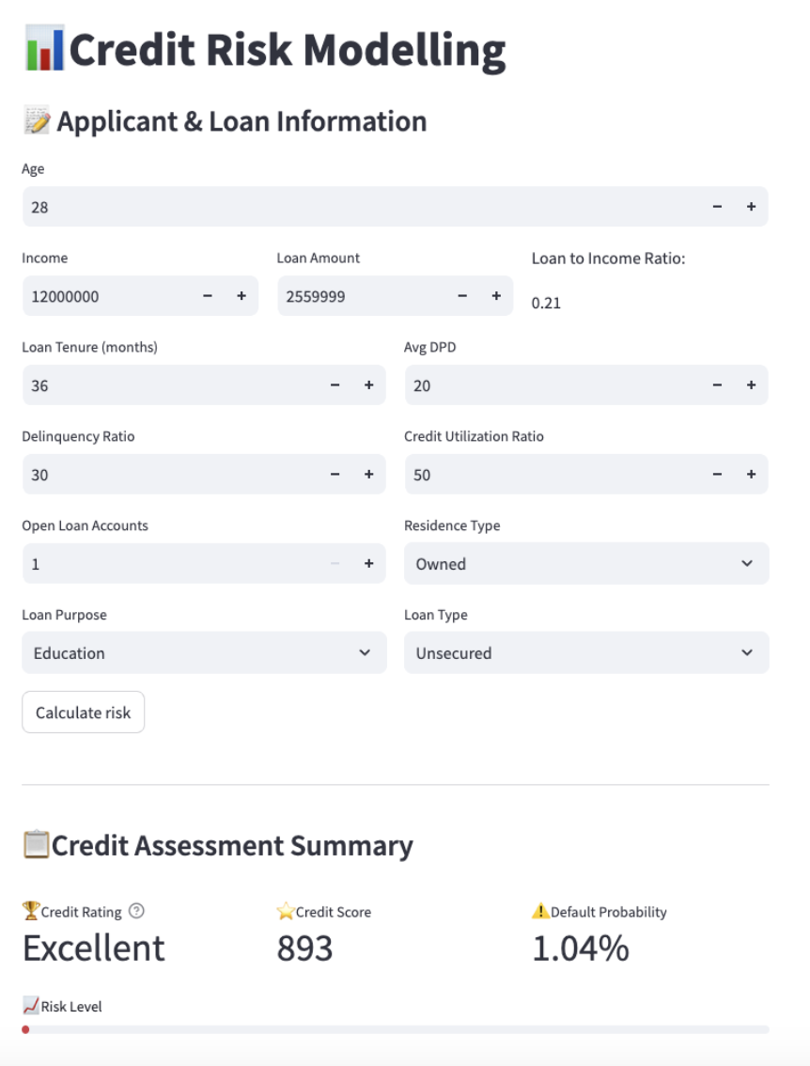
Sample App Screenshot

Slide 26
THANK YOU

